Slide 1
Conversion of RE to FA
To convert the RE to FA, we are going to use a method called the subset method. This method is used to obtain FA from the given regular expression. This method is given below:
Step 1: Design a transition diagram for given regular expression, using NFA with ε moves.
Step 2: Convert this NFA with ε to NFA without ε.
Step 3: Convert the obtained NFA to equivalent DFA.

Slide 2
Converting a RE to an ε-NFA
Proof is an induction on the number of operators (+, concatenation, *) in the RE.
We always construct an automaton of a special form (next slide).

Slide 3
DFA, NFA, Ɛ-NFA and Regular Expression(RE)
RE
DFA
Ɛ-NFA
NFA

Slide 4
Form of ε-NFA’s Constructed
No arcs from outside,
no arcs leaving
Start state:
Only state
with external
predecessors
“Final” state:
Only state
with external
successors

Slide 5
RE to ε-NFA: Basis
Symbol a:
ε:
∅:
a
ε

Slide 6
RE to ε-NFA: Induction 1 – Union
For E₁
ε
ε
For E₂
ε
ε
For E₁ ∪ E₂

Slide 7
RE to ε-NFA: Induction 2 – Concatenation
For E₁
For E₂
ε
For E₁E₂

Slide 8
RE to ε-NFA: Induction 3 – Closure
ε
For E
ε
ε
ε
For E*

Slide 9
RE to ε-NFA construction
Reg Ex
ε -NFA
Theorem
Example:
(0+1)*01(0+1)*
(0+1)*
01
(0+1)*
ε
ε
ε
0
ε
ε
0
ε
ε
0
1
ε
1
ε
ε
1
ε
ε
ε

Slide 10
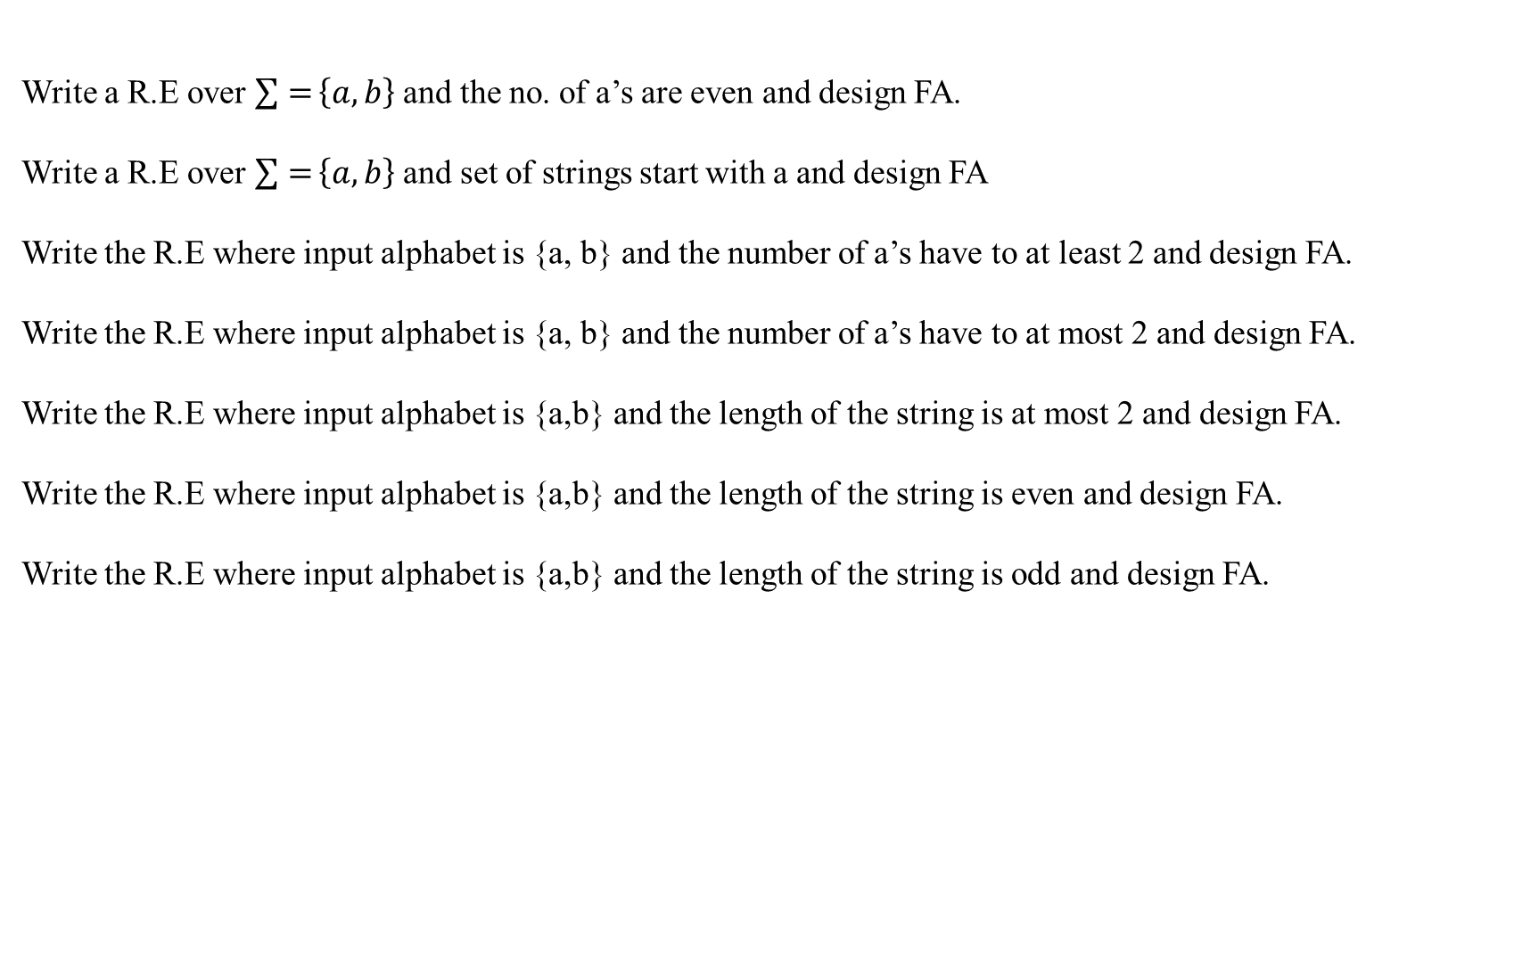
Write a R.E over $\sum{=}\left\{a,b\right\}$ and the no. of a’s are even and design FA.
Write a R.E over $\sum{=}\left\{a,b\right\}$ and set of strings start with a and design FA
Write the R.E where input alphabet is {a, b} and the number of a’s have to at least 2 and design FA.
Write the R.E where input alphabet is {a, b} and the number of a’s have to at most 2 and design FA.
Write the R.E where input alphabet is {a,b} and the length of the string is at most 2 and design FA.
Write the R.E where input alphabet is {a,b} and the length of the string is even and design FA.
Write the R.E where input alphabet is {a,b} and the length of the string is odd and design FA.

